Slide 1

Topic 13:
Source control
[Date of Training]
Notes:
Participants log in and get settled.

Slide 2
Agenda
Introductions
What Is Source Control? Why Does It Matter?
How Can Masks Stop Germs at the Source?
Reflection
Notes:
Facilitator Notes
Welcome
Housekeeping, either orally or via chat
If needed, additional notes specific to the platform you’re using (e.g., how to “raise your hand,” how to post questions)
Overview of agenda
If this session is part of an ongoing series, you may choose to say “welcome back,” “thank you for joining us again,” etc.
Sample Script
“Welcome to Project Firstline. Thank you for joining us! Before we begin, a few housekeeping notes. We’ll meet today for 20 minutes. Please keep your videos on, to the extent possible, and keep your microphone muted when you are not contributing to the discussion. It’s great to see you all here today!
“Today, we’ll focus on the importance of source control. We’ll talk about what it is, why it matters, and how we use masks for source control. We’ll also have an opportunity to reflect before we wrap up for the day.”

Slide 3
Learning Objectives
Explain how source control keeps germs from spreading.
Discuss one (1) reason why source control for COVID-19 focuses on masking.
Notes:
Facilitator Notes
Provide an overview of the session’s Learning Objectives.
Sample Script
“Here is what we expect to learn today. After today, you’ll be able to explain how source control keeps germs from spreading, and you’ll understand why masks are such an important part of source control for COVID-19.”

Slide 4
INTRODUCTIONS
Your name
Your role
Notes:
Facilitator Notes
These questions will give you a better understanding of your participants’ backgrounds, experience, and level of knowledge.
Tailor your slide delivery for the virtual format and platform, and the number of participants:
You may wish to add role- or facility-specific questions to the introductions.
If you have a large group, you may decide to skip introductions and use the chat or poll feature for introductions.
If your group meets regularly, you may wish to skip or shorten the introductions, or use a different “icebreaker” approach.
Be sure to introduce yourself, and anyone who is assisting you.
Sample Script
“Let’s take a minute to get to know each other. Please share in a few seconds your name and your role at work.”

Slide 5
Definition
Source control for COVID-19
Use of well-fitting cloth masks, facemasks, or respirators to cover a person’s mouth and nose to prevent spread of respiratory secretions when they are breathing, talking, sneezing, or coughing.
Notes:
Facilitator Notes
Either allow time for participants to read the definition themselves or read it aloud: “Use of well-fitting cloth masks, facemasks, or respirators to cover a person’s mouth and nose to prevent spread of respiratory secretions when they are breathing, talking, sneezing, or coughing.”
CDC source for the definition: https://www.cdc.gov/coronavirus/2019-ncov/hcp/infection-control-recommendations.html#source-control
You may choose to ask participants to answer, either verbally or in the chat, why they think that source control for COVID-19 focuses on masking.
Establish:
Source control keeps germs from spreading by stopping them at their source.
For COVID-19, source control focuses on covering the nose and mouth with a mask to keep respiratory droplets out of the air.
A mask should fit well, without gaps at the edges, and cover your nose and mouth. This way, the mask blocks respiratory droplets that are released into the air when you breathe, talk, sing, cough, or sneeze.
Sample Script
“Source control is an important tool to keep germs from spreading. It stops germs at their source, before they can spread to other people.
“Let’s review this definition of source control from CDC. Go ahead and read the definition to yourself.” (Pause as participants read.)
“This definition specifically refers to source control for respiratory viruses, like SARS-CoV-2. It focuses on covering the mouth and nose to keep respiratory droplets out of the air. Does anyone have an idea why?”
(Pause for responses, either in chat or aloud.)
“That’s right. Wearing a mask for source control blocks your respiratory droplets from being released into the air. A mask should fit well, without gaps at the edges, and cover your nose and mouth. This is important because people who are infected with SARS-CoV-2, the virus that causes COVID-19, have virus in their respiratory droplets that can spread to other people and the environment.
“Now we’ll check in with the CDC’s Dr. Abby Carlson and then discuss together what we’ve learned.”

Slide 6
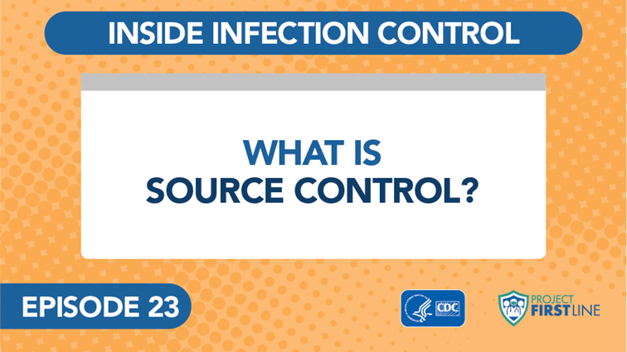
Video - Inside Infection Control: What is Source Control? Episode 23
Notes:
Facilitator Notes
Access the video here:
CDC Website: https://www.cdc.gov/infectioncontrol/projectfirstline/videos/Ep23-Source-LowRes-New.mp4
OR
Project Firstline YouTube Playlist: https://www.youtube.com/watch?v=9C2wwGm_Su4&list=PLvrp9iOILTQZQGtDnSDGViKDdRtIc13VX&index=24

Slide 7
What did we learn about source control?
Notes:
Facilitator Notes
After the episode, ask the group to discuss what they learned about source control from this video and why source control is important for COVID-19.
You may choose to ask participants to share their reactions orally, via chat, or both.
Sample Script
“Take a moment to review the notes you took during the video. What did you learn about source control? Specifically, why is source control important for COVID-19 care? Would someone like to respond?”
(Pause to allow for responses. Encourage additional discussion.)

Slide 8
Source control for COVID-19
For COVID-19, source control focuses on covering your nose and mouth with a mask to keep your respiratory droplets out of the air.
Why does that matter?
The main way that SARS-CoV-2, the virus that causes COVID-19, travels between people is through respiratory droplets that come out when an infected person talks, breathes, coughs, or otherwise blows air out of their nose or mouth.
Notes:
Facilitator Notes
This slide has animations for the second column. When you advance to the slide, only the first column will appear.
After you introduce the concept, ask participants to share, either by coming off mute or via chat, answers to the question, “Why?”
After they provide responses, use the animation to reveal the answers.
The Content Outline for Episode 23 of the video series provides additional discussion points that you may wish to use.
Depending upon your context and audience, you may wish to refer to CDC’s Interim Infection Prevention and Control Recommendations for Healthcare Personnel During the Coronavirus Disease 2019 (COVID-19) Pandemic (https://www.cdc.gov/coronavirus/2019-ncov/hcp/infection-control-recommendations.html), which include the most recent recommendations for source control for healthcare workers who have been fully vaccinated against COVID-19.
Sample Script
“Source control for COVID-19 is critical to preventing the spread of respiratory droplets. We cover our nose and mouth with a mask to keep the respiratory droplets that we breathe out, out of the air and away from other people. Why does that matter?”
(Pause for responses.)
“Yes! When we stop those respiratory droplets at the source, we keep the virus from spreading.”

Slide 9
we don’t always know who’s infected with sars-cov-2
People who are infected with SARS-CoV-2 may not show symptoms and may not be aware that they have the virus.
Why does that matter?
They can still spread the virus to others through their respiratory droplets, which is why source control for COVID-19 is so important.
Notes:
Facilitator Notes
This slide has animations for the second column. When you advance to the slide, only the first column will appear.
After you introduce the concept, ask participants to share, either by coming off mute or via chat, answers to the question, “Why?”
After they provide responses, use the animation to reveal the answers.
The Content Outline for Episode 23 of the video series provides additional discussion points that you may wish to use.
Sample Script
“Source control is especially important for COVID-19 because we don’t always know who is infected. Why does that matter?”
(Pause for responses.)
“That’s right. We don’t always know who’s infected, because people can be infected but not show any symptoms – that’s called being asymptomatic. It matters because the virus can still spread from someone who is infected, but who doesn’t feel sick.”

Slide 10
How can masks stop germs at the source?
Notes:
Facilitator Notes
Invite participants to return to their notes from the video, and to think specifically about what they learned about masking for source control.
You may choose to ask participants to share their reactions orally, via chat, or both.
Sample Script
“Now we’re going to focus on using masks for source control. Take a minute to review your notes from the video again. What did you learn about the use of masks for source control? Why do we use masks, and how do they prevent the spread of disease?”
(Pause to allow for responses. Encourage additional discussion.)

Slide 11
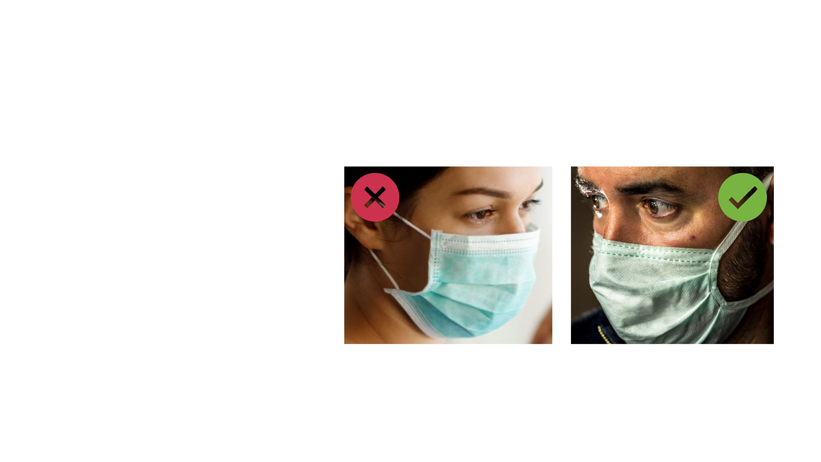
Source control tips: Masks
Wear a mask that
Fits snugly around the cheeks and chin without gaps at the edges
Covers your mouth and nose
Notes:
Facilitator Notes
Emphasize that it is important for a mask used for source control to fit well.
You may wish to provide examples of masks that do not fit well, for comparison.
From the CDC: “Facemasks that conform to the wearer’s face so that more air moves through the material of the facemask rather than through gaps at the edges can also reduce the wearer’s exposure to particles in the air.” (Infection Control: Severe acute respiratory syndrome coronavirus 2 (SARS-CoV-2) | CDC)
If asked about masking recommendations for healthcare workers who have been fully vaccinated against COVID-19, you may refer participants to CDC’s Interim Infection Prevention and Control Recommendations for Healthcare Personnel During the Coronavirus Disease 2019 (COVID-19) Pandemic (https://www.cdc.gov/coronavirus/2019-ncov/hcp/infection-control-recommendations.html).
Sample Script
“As we heard in the video, source control protects others. Wearing a mask that covers your mouth and nose can block your respiratory droplets from reaching others when you breathe, talk, sneeze, or cough.
“When it comes to wearing a mask, your mask should fit well, without gaps at the edges, and cover your mouth and nose. This makes it less likely that your respiratory droplets can reach people and things around you, as well as makes it a source of protection for you.”

Slide 12
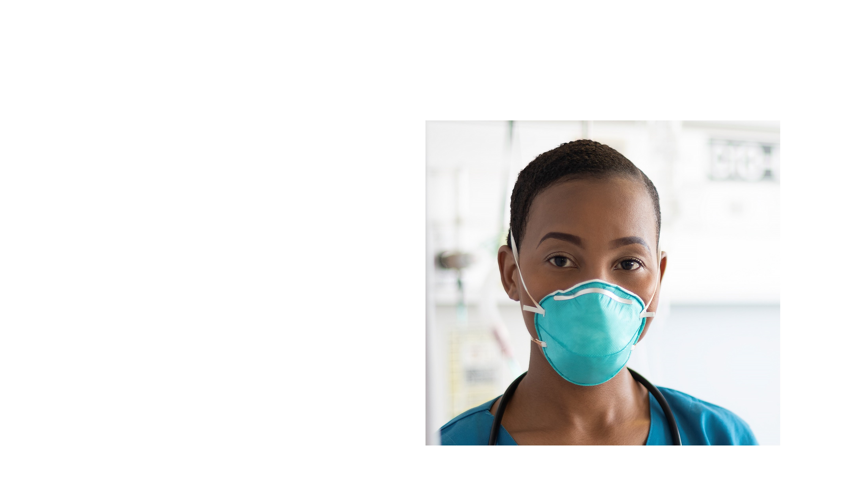
Source control tips: N95s
N95s protect you from breathing in respiratory droplets.
Most N95s also block your respiratory droplets from being breathed out into the air.
Notes:
Facilitator Notes
Reinforce that N95 respirators not only protect the wearer from breathing in respiratory droplets, but many of them also serve as source control, blocking the wearer’s respiratory droplets.
Depending on your audience, you may wish to refer to other episodes of Inside Infection Control, or to other elements in the Facilitator Toolkit, to add to the discussion of N95 respirators.
If this session is part of a series and your group has discussed N95 respirators before or plans to in the future, you may wish to refer to that information.
Sample Script
“Some of you may have cared for patients with COVID-19 and used an N95 respirator. Most N95s used in healthcare are also good for source control because they block your respiratory droplets from being breathed out into the air. So not only are you protected from virus that your patient is breathing out, if you’re infected, your patients and your colleagues are also protected from any virus that you’re breathing out.”

Slide 13
Reflection
Notes:
Facilitator Notes
Transition to wrap-up of session.
Sample Script
“Let’s use our last few minutes together to reflect on what we’ve learned and think about how we can put what we’ve learned into practice.”

Slide 14
Questions?
Notes:
Facilitator Notes
Invite additional, remaining questions.
You may choose to ask participants to respond orally, in the chat, or both.
If the answers are information that is already included in this session, please respond.
If the questions address content that is not covered in this session, please do not attempt to answer. Instead, take note of the questions and consult with CDC resources to follow up with answers after the session.
Sample Script
“Thank you all for your time! Please take a moment to reflect on today’s session and share any remaining questions you have. Does anyone have any questions still remaining?”
(Address questions as appropriate.)
“Thank you for sharing those questions. Project Firstline is actively collecting your questions to help inform more training resources as they’re developed. I’ve written them down and I will get back to you with responses.”

Slide 15
Key takeaways
Source control keeps germs from spreading by stopping them at their source, before they can spread to other people.
Source control is an important tool to reduce the spread of COVID-19 and other respiratory infections as well as other diseases.
For COVID-19, source control focuses on covering your nose and mouth with a mask to keep your respiratory droplets out of the air.
Most N95 respirators used in healthcare not only protect you from virus that your patient is breathing out, but also protect your patients and your colleagues from germs that you might be breathing out.
Notes:
Facilitator Notes
Review key takeaways.
You may choose to revisit discussion points or questions that arose during the session.
Sample Script
“I hope this training gave you some good information about source control, and why it’s so important. I’ve captured some key takeaways here, which you can review at your leisure after the session today.”

Slide 16
Resources and Future Training sessions
Project Firstline on CDC:
https://www.cdc.gov/infection control/projectfirstline/index.html
CDC’s Project Firstline on Facebook:
https://www.facebook.com/CDCProjectFirstline
CDC’s Project Firstline on Twitter:
https://twitter.com/CDC_Firstline
Project Firstline Inside Infection Control on YouTube:
https://www.youtube.com/playlist?list=PLvrp9iOILTQZQGtDnSDGViKDdRtIc13VX
To sign up for Project Firstline e-mails, click here: https://tools.cdc.gov/campaignproxyservice/subscriptions.aspx?topic_id=USCDC_2104
Notes:
Facilitator Notes
Share additional resources from Project Firstline and CDC.
Explain how participants can reach you, by the means of your choosing, and how they can reach Project Firstline.
If this session is part of a series, you may choose to describe the themes of upcoming sessions.
Sample Script
“We covered a lot today, and there is still more to learn. You can keep exploring these topics on your own using the resources on this slide. You can also follow us on social media. I will stay on the line for a few minutes after our session ends and will be happy to discuss any other questions!”
(If this session is part of a series) “Next time, we will cover [insert training topic].”

Slide 17
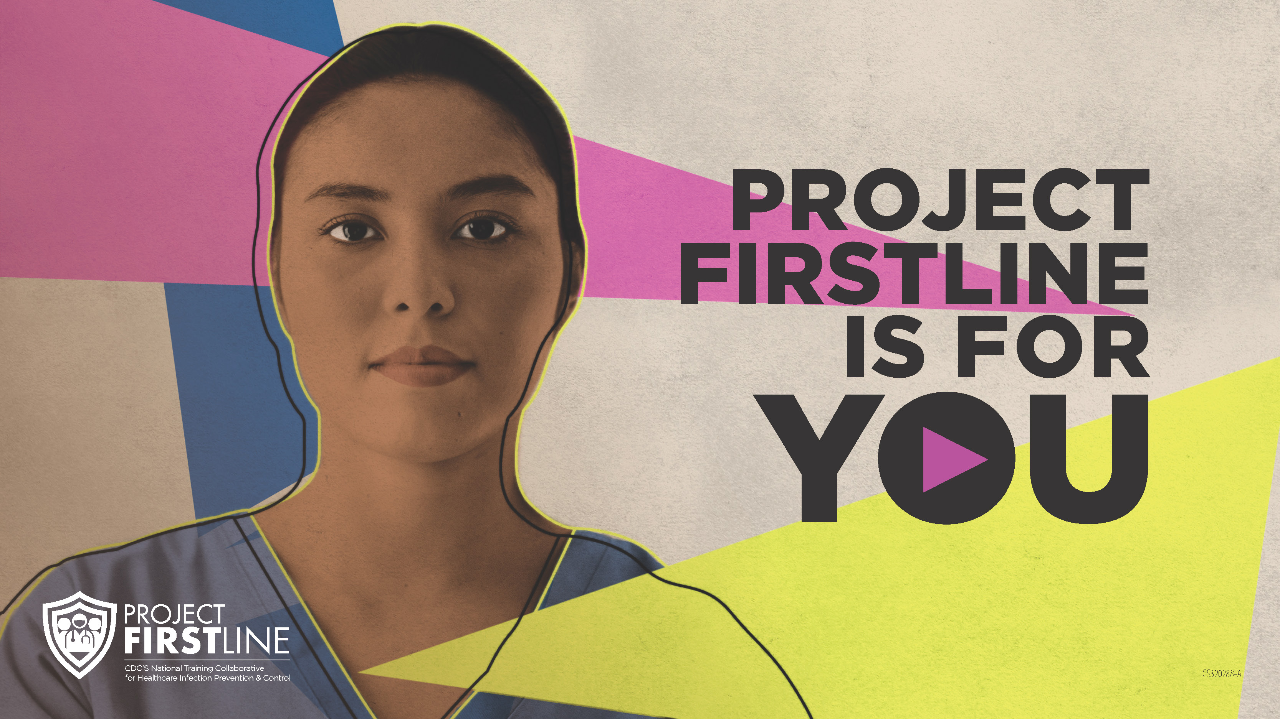
Feedback Form
Notes:
Facilitator Notes
Explain how to access the Feedback Form.
Sample Script
“And, finally, please let us know how you enjoyed today’s session by completing the following feedback form. Thanks again for joining us today.”
After the Session
Send list of participant questions compiled during this session to ProjectFirstline@cdc.gov.

